Slide 1

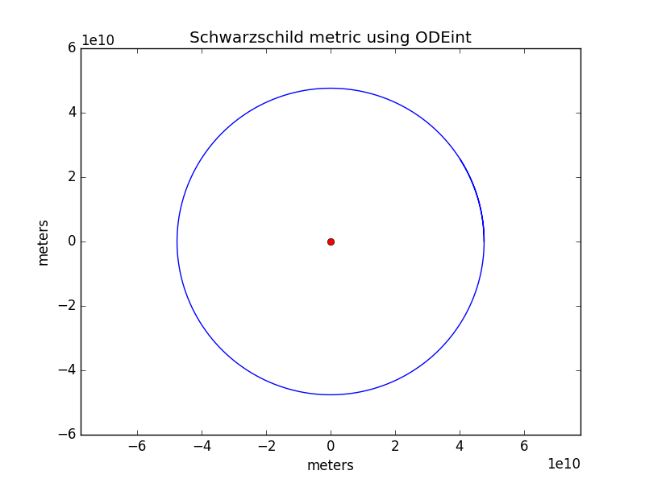
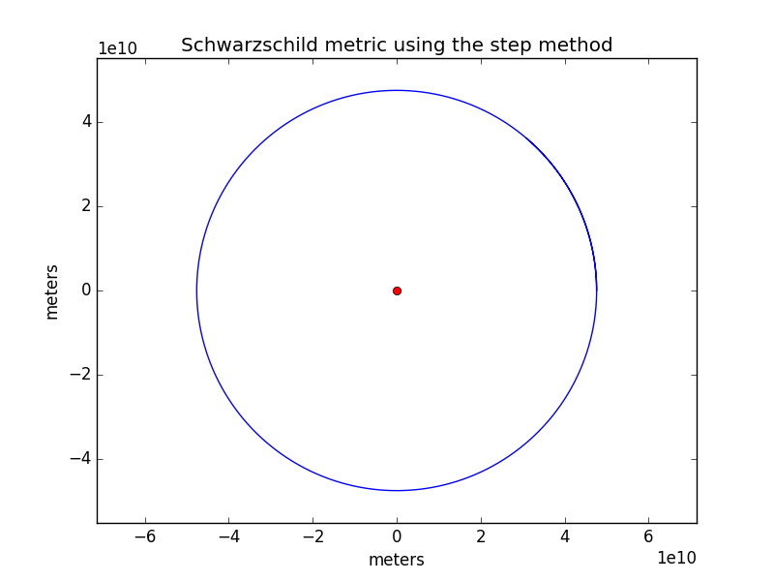
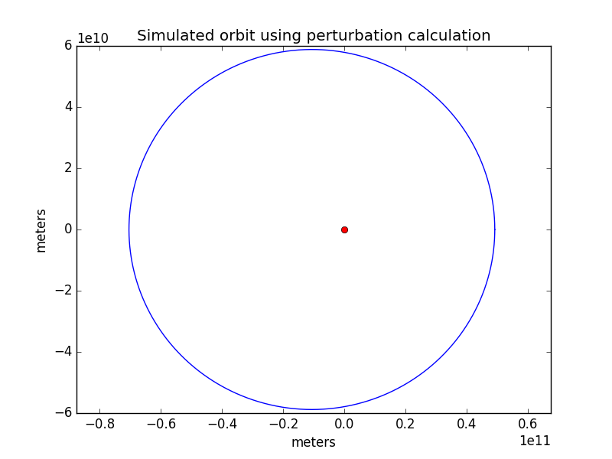
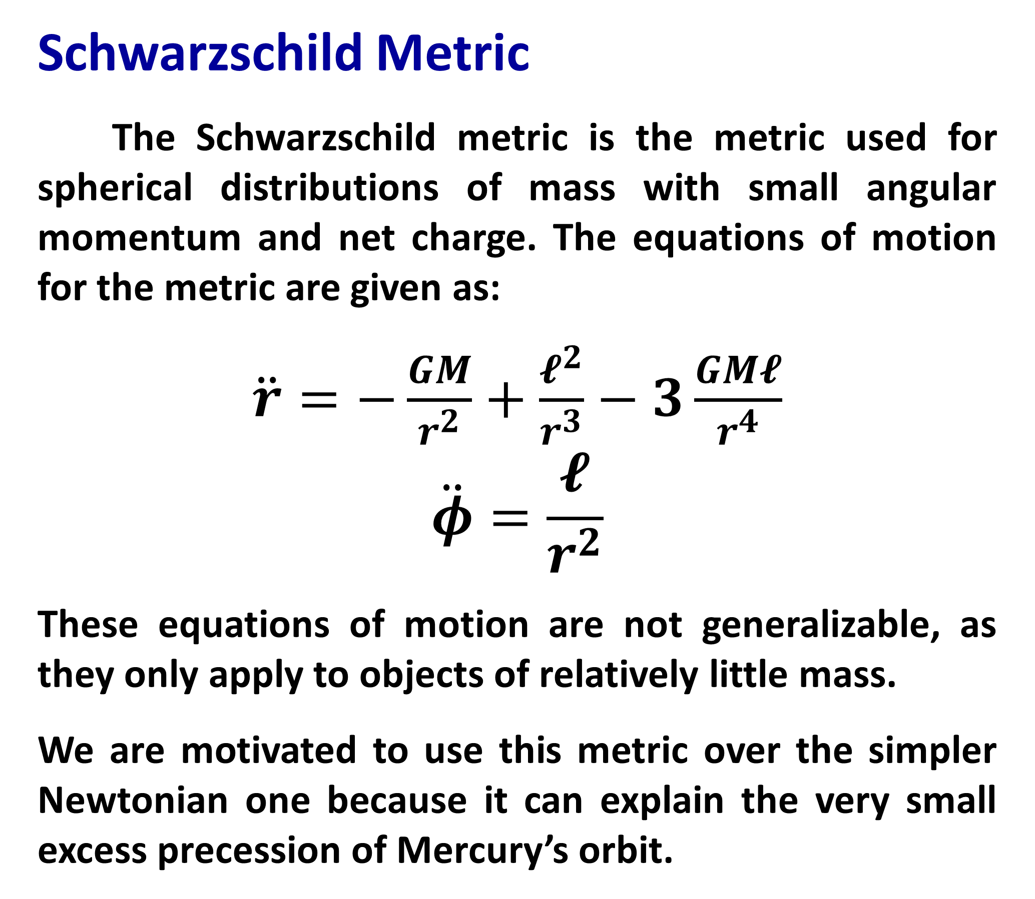
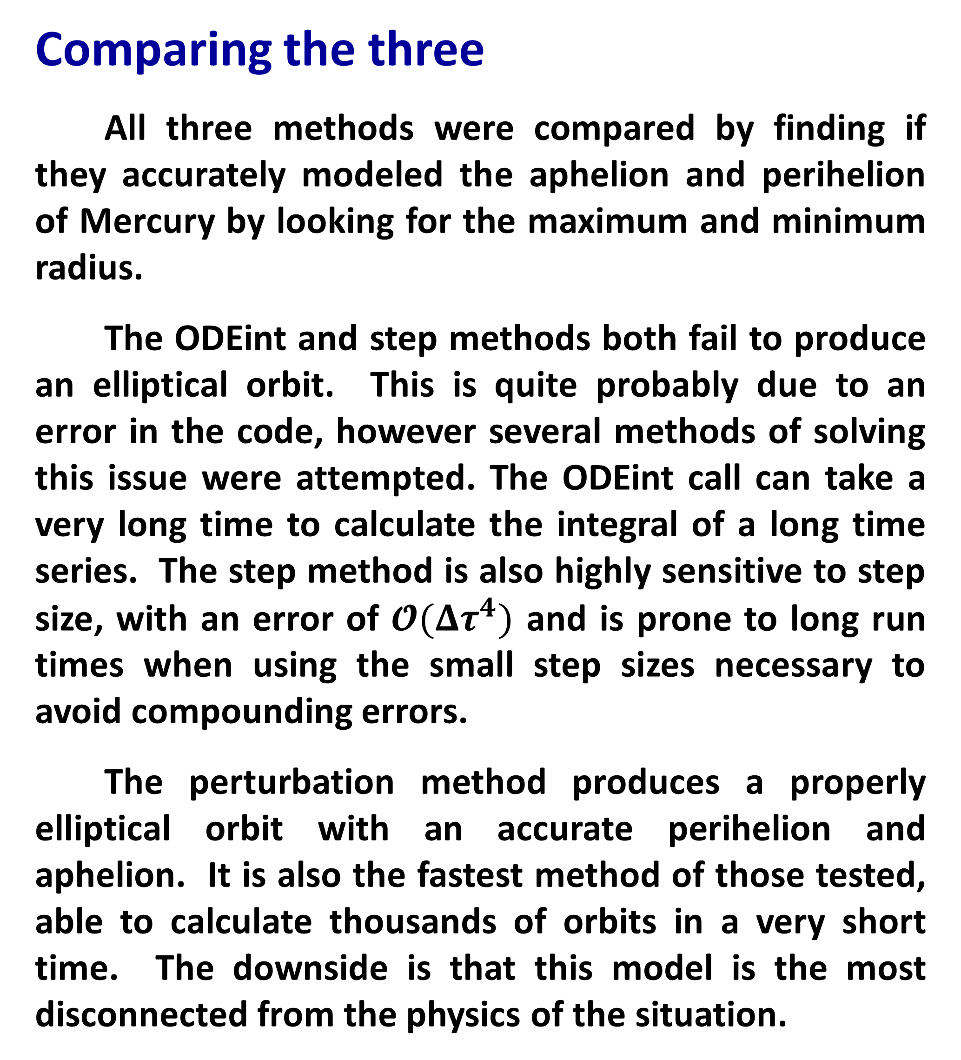
Three methods of plotting the orbit of Mercury
Ian Blackstone
Project Introduction
This project looked at three different methods of calculating the obit of Mercury about the Sun.
The first method uses the scipy odeint function to integrate the equations of motion derived from the Schwarzschild metric. This involved finding the radial and angular position and velocities, finding the derivatives of these and feeding those derivatives into numpy.integrate.odeint.
The second method uses the Verlet method to propagate the solution forward in time. The first step is determined through a simple approximation and subsequent steps are then generated from the Verlet equations (Moore, 2012).
The third method skips solving an ODE and instead models the motion of the planet as a circular orbit that is shifted by a perturbation function that depends on the angle phi. This method requires some knowledge of the planet’s orbit before hand, but is the simplest of all the methods (Moore, 2012.
Comparing the three
All three methods were compared by finding if they accurately modeled the aphelion and perihelion of Mercury by looking for the maximum and minimum radius.
The ODEint and step methods both fail to produce an elliptical orbit. This is quite probably due to an error in the code, however several methods of solving this issue were attempted. The ODEint call can take a very long time to calculate the integral of a long time series. The step method is also highly sensitive to step size, with an error of $𝓞(Δτ^{4})$ and is prone to long run times when using the small step sizes necessary to avoid compounding errors.
The perturbation method produces a properly elliptical orbit with an accurate perihelion and aphelion. It is also the fastest method of those tested, able to calculate thousands of orbits in a very short time. The downside is that this model is the most disconnected from the physics of the situation.
Conclusion
The main motivation for modeling the orbit of mercury using general relativity is to show the precession of Mercury’s orbit, however if we run the ODE or step methods over long enough time periods and with high enough resolution we will quickly run into limitations of memory and processing time.
For long term modeling of Mercury’s orbit using Python new methods will need to be investigated, the most promising method is the IAS15 integrator built specifically to handle gravitational dynamics (Rein, Spiegel, 2014).
Schwarzschild Metric
The Schwarzschild metric is the metric used for spherical distributions of mass with small angular momentum and net charge. The equations of motion for the metric are given as:
$\ddot{r}=−\frac{GM}{r^{2}}+\frac{𝓵^{2}}{r^{3}}−3\frac{GM𝓵}{r^{4}}$
$$\ddot{φ}=\frac{𝓵}{r^{2}}$$
These equations of motion are not generalizable, as they only apply to objects of relatively little mass.
We are motivated to use this metric over the simpler Newtonian one because it can explain the very small excess precession of Mercury’s orbit.
Acknowledgments
Thank you to Dr. Macomb and Dr. Jackson for their input and help with this project.
References
Rein, H. Spiegel, D. IAS15: a fast, adaptive, high-order integrator for gravitational dynamics, accurate to machine precision over a billion orbits. MNRAS, Oct 2014.
Moore, T. A General Relativity Workbook. University Science Books, Sep 2012.

